Slide 1
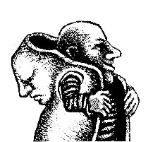
Geometry of Data Sets,
Topological Grammars, and Dynamical Phenotypes
Alexander Gorban
with
Andrei Zinovyev
Notes:
Geometry of data sets
The three line abstract:
How to unravel geometry and topology hidden in a finite set of data points? The sequence of discoveries and algorithms is presented: from Gauss to Pearson and from Pearson to modern manifold learning algorithms, topological grammars and algebraic statistics, which promises a synthesis between algebraic geometry and data mining.

Slide 2
Plan
The problem
Approximation of multidimensional data by low-dimensional objects
Elastic Manifolds
Comparison with PCA
Pluriharmonic graph embedment
Topological grammars
Examples
Dynamic phenotypes

Slide 3
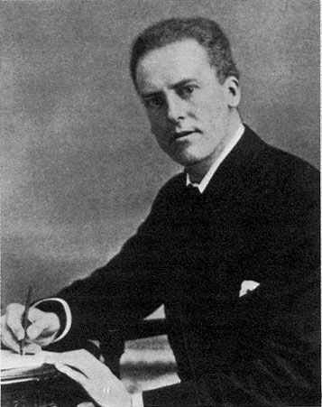
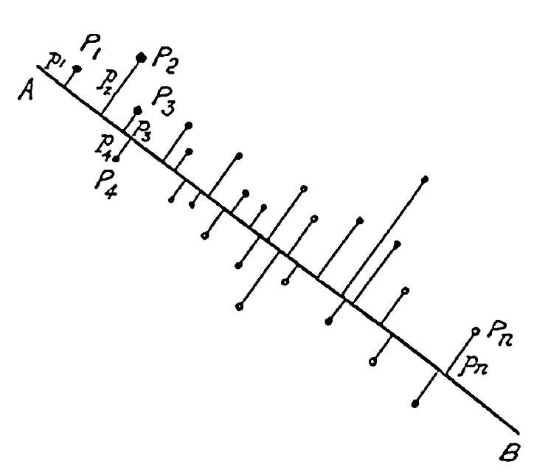
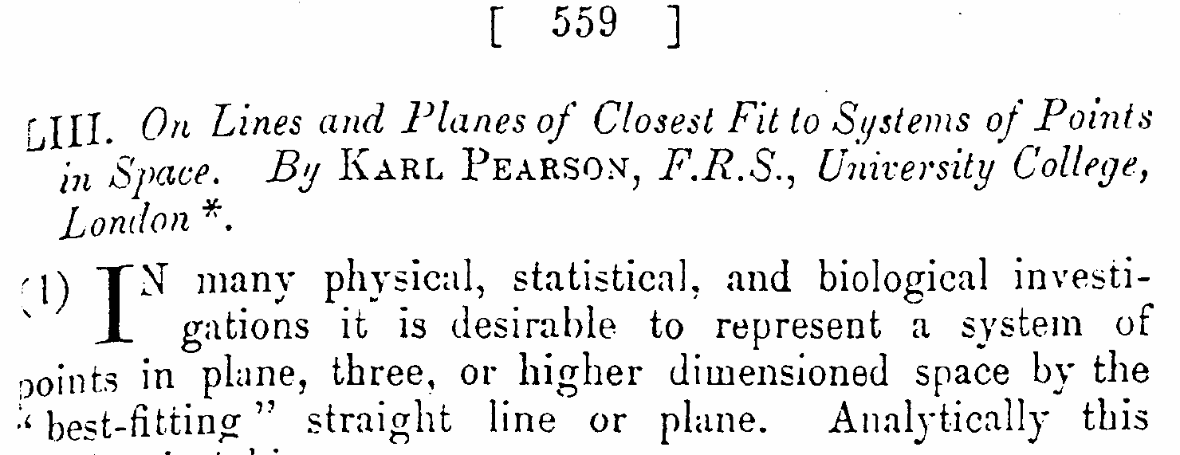
Karl Pearson
1901

Slide 4

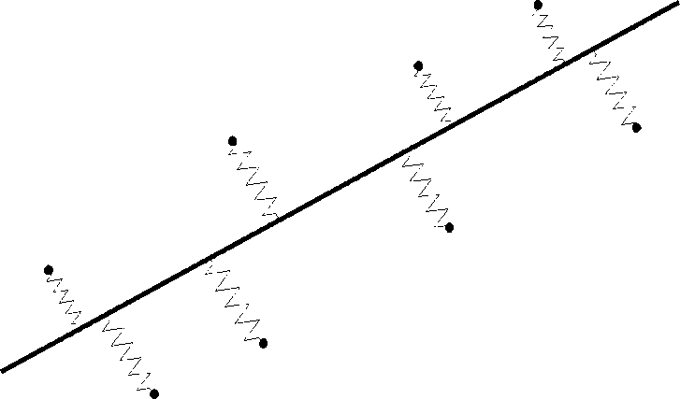
Principal Component Analysis
Approximation by straight lines:
Subtract the projection
and repeat
Minimal squared
averaged distance
Minimal energy!
Maximal variance
1st Principal
axis

Slide 5
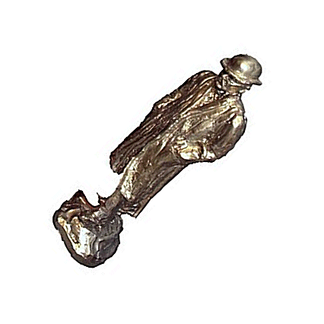
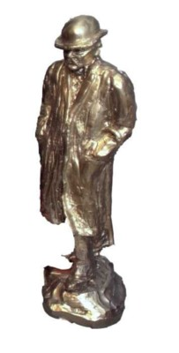
Principal “Object”

Slide 6
Principal points (K-means)
Approximation
by smaller finite sets:
Select several centres;
Attach datapoints to the closest centres by springs;
Minimize energy;
Repeat 2&3 until converges.
Centres y^{(i)}
Steinhaus, 1956;
Lloyd, 1957;
MacQueen, 1967
Data points x^{(j)}

Slide 7
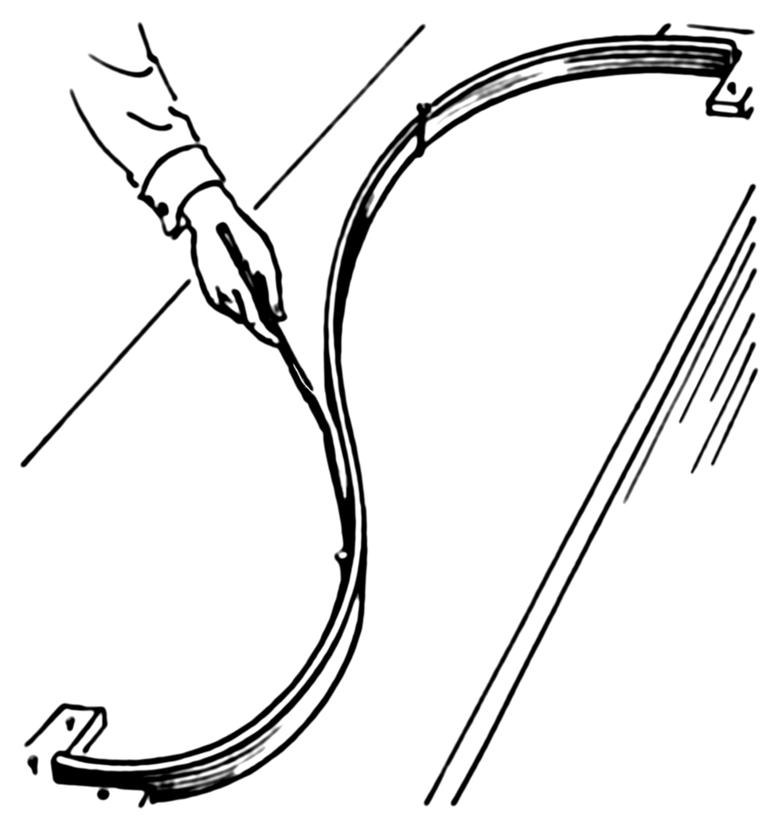
Definition of elastic energy: we borrow this approach from splines

Slide 8
Metaphor of elasticity: elastic net
U^{(Y)}
Positive
springs
U^{(E)}
Negative
springs
Data
points
Grid
nodes
U(R)

Slide 9
Definition of elastic energy
X^{j}
y
E (0)
E (1)
R (1)
R (0)
R (2)

Slide 10

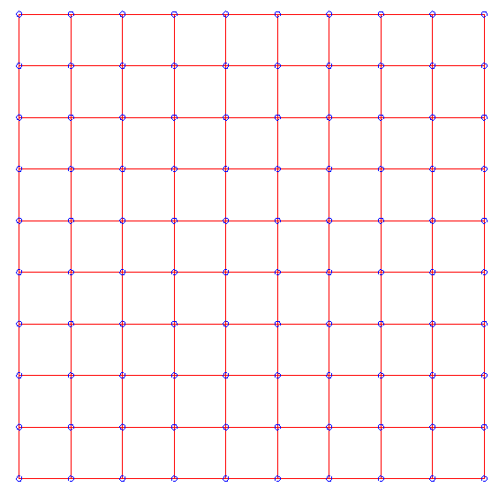
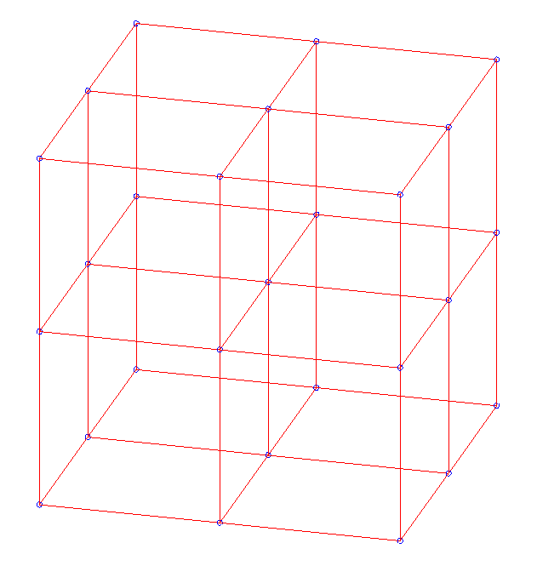
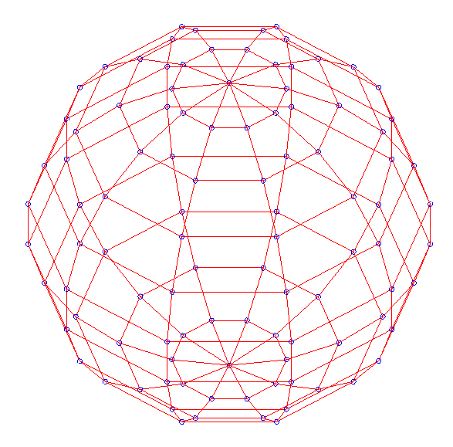
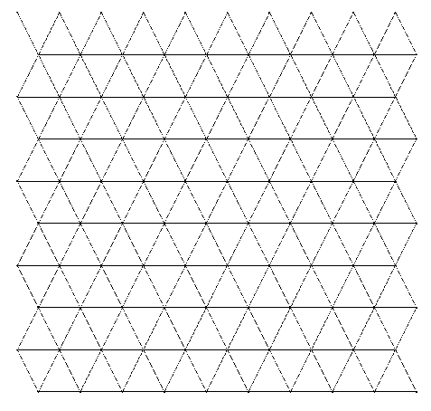
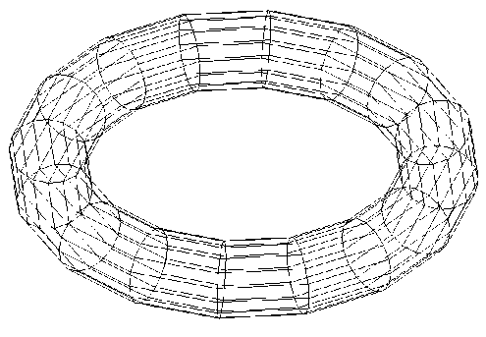
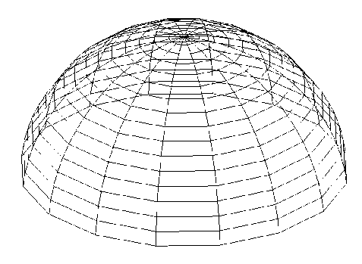
Assembling elastic nets
y
E (0)
E (1)
R (1)
R (0)
R (2)

Slide 11
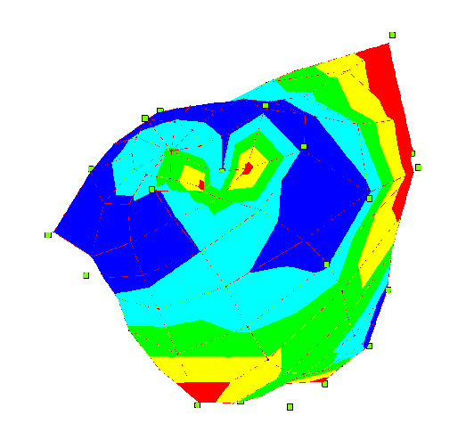
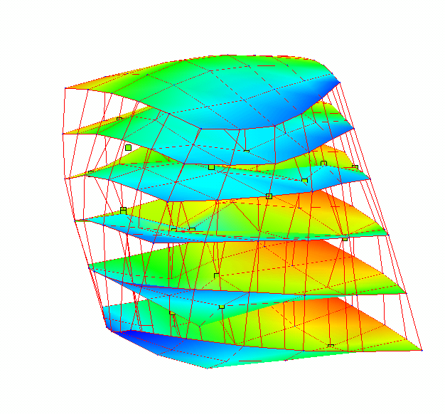
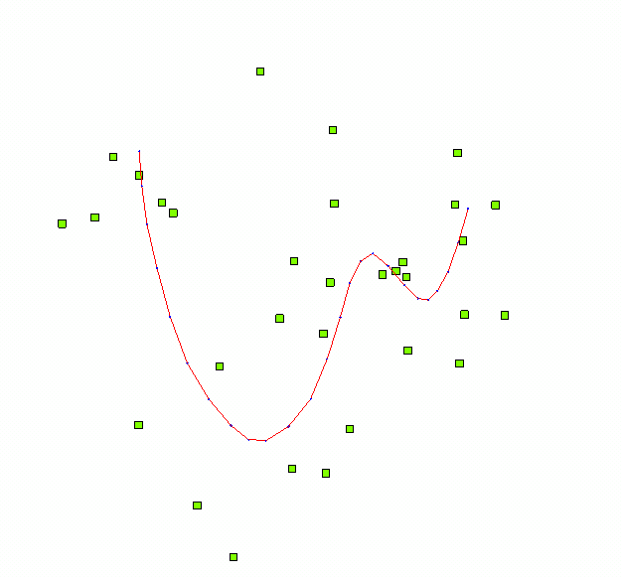
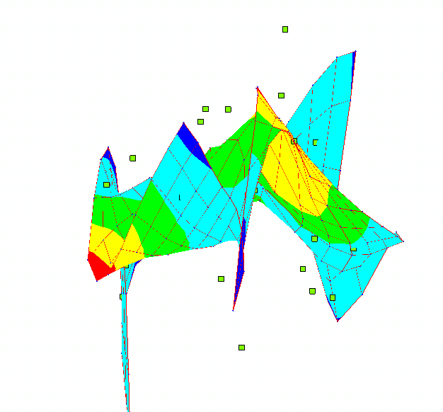
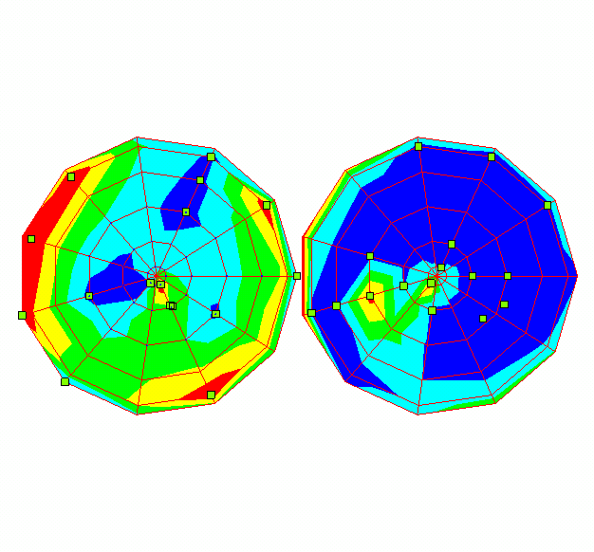
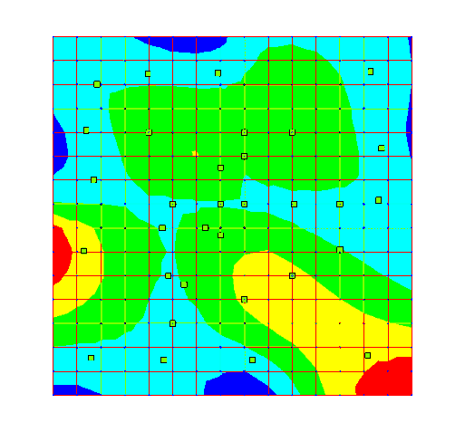
Various manifold topologies
R^{N}
R²

Slide 12
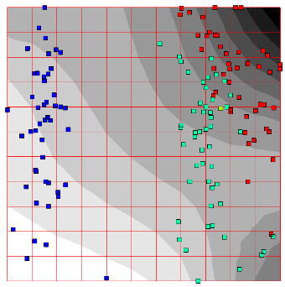
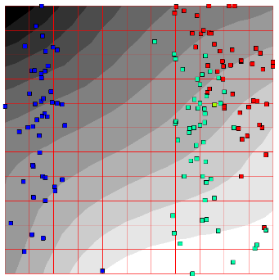
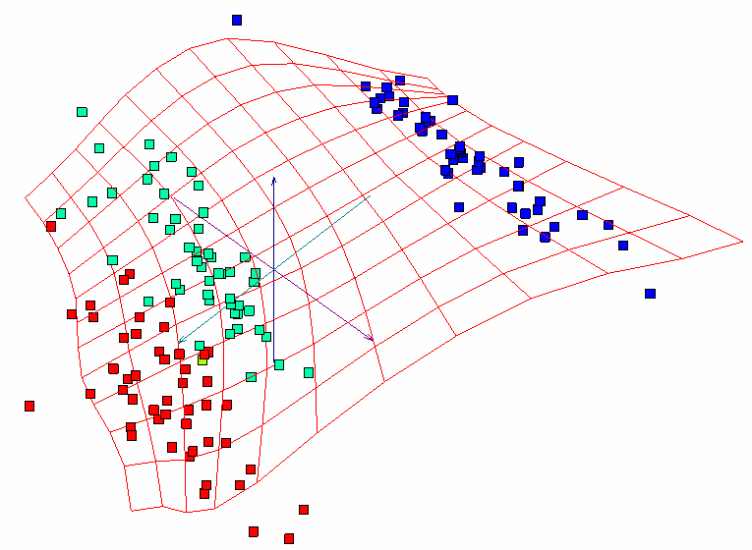
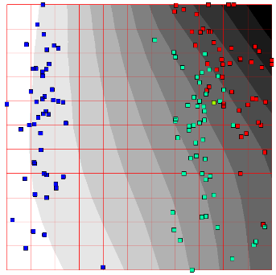
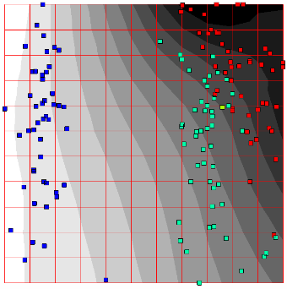
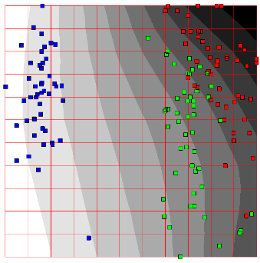
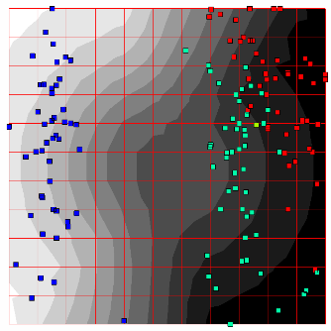
Colorings: visualize any multidimensional function
max
Four dimensional space
(x¹_{i}, x²_{i}, x³_{i}, x⁴_{i})
F(x1,x2,x3,x4) = x1
F(x1,x2,x3,x4) = x2
min
F(x1,x2,x3,x4) = x3
F(x1,x2,x3,x4) = x4
F = F(x1,x2,x3,x4)
F= -0.4x1+0.3x2-0.5x3-0.5x4
F= x1²+x2²+x3²+x4²

Slide 13
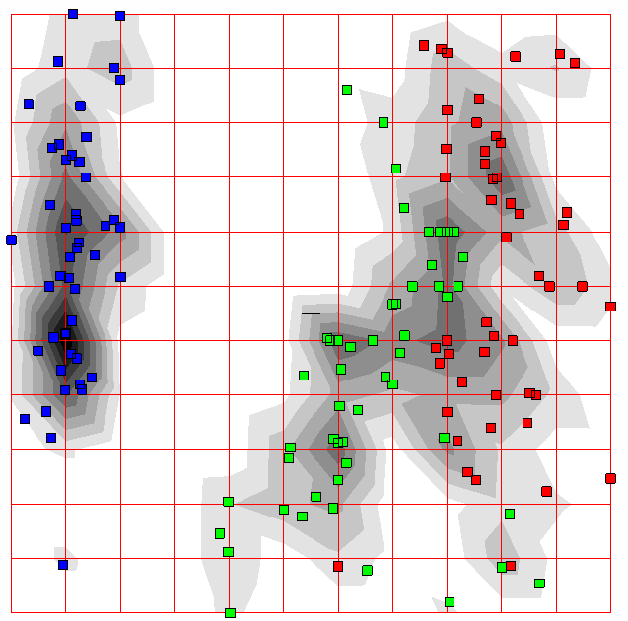
Example of complex function: point density

Slide 14
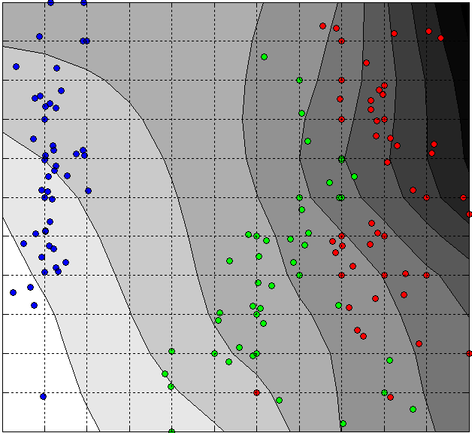
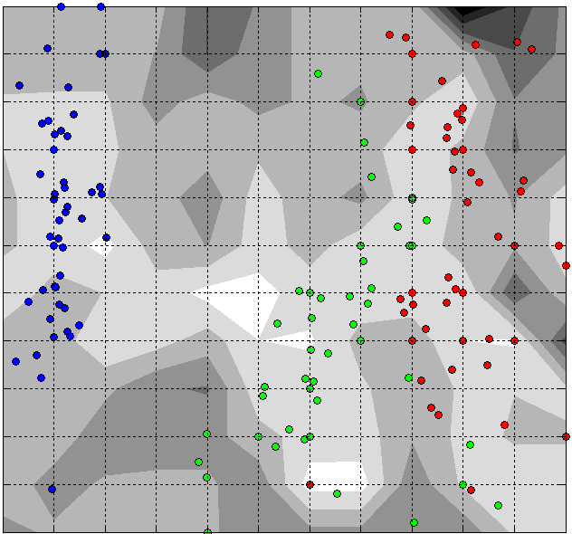
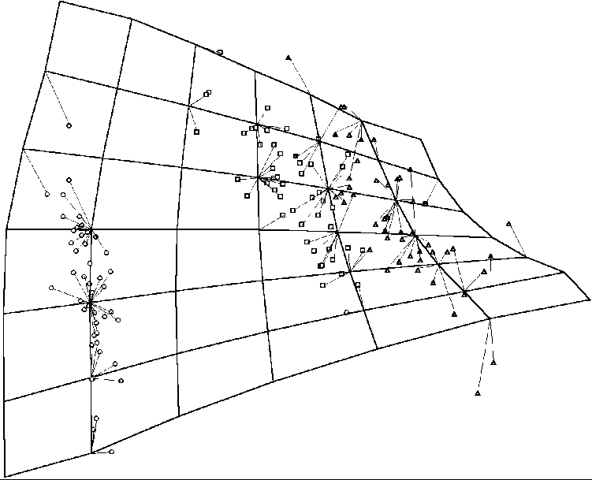
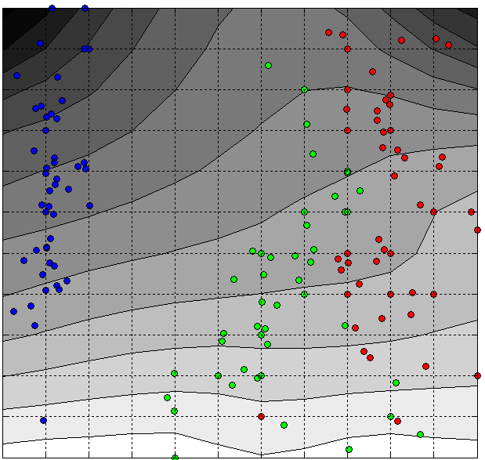
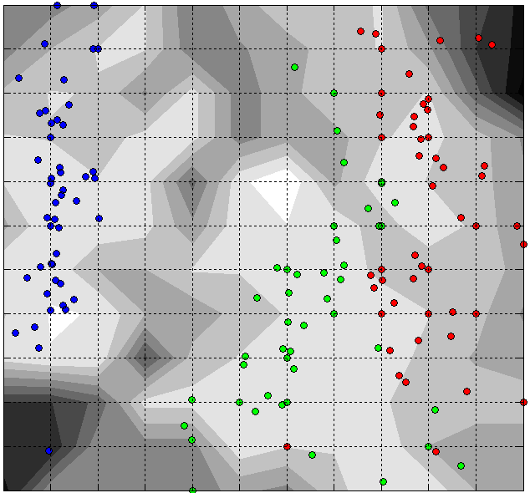
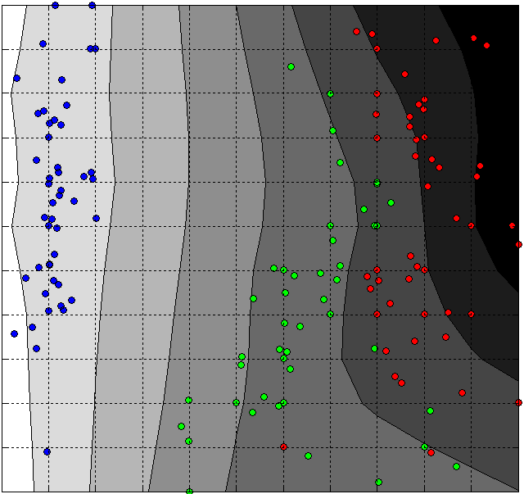
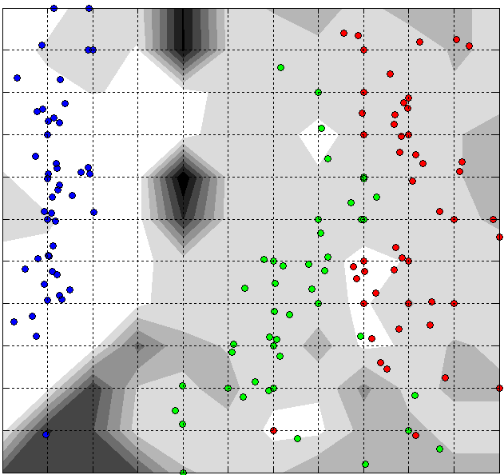
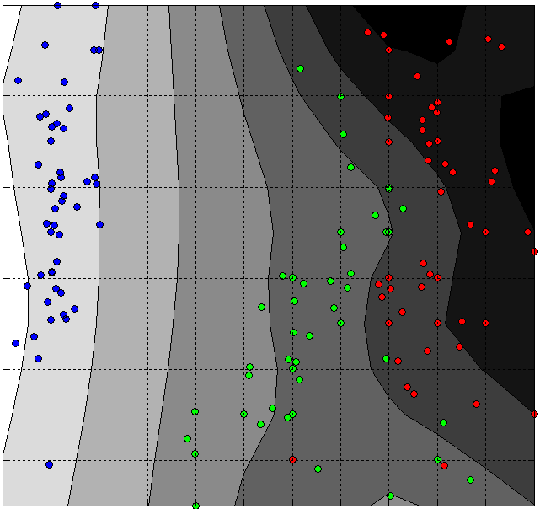
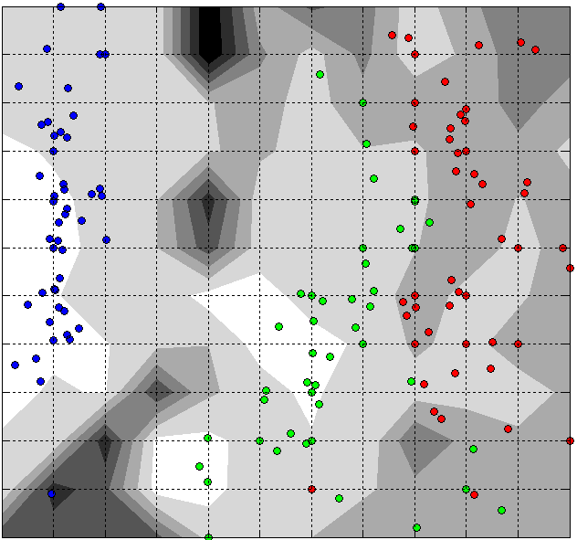
Visualization of uncertainty kNN methodology
uncertainty
field
value
high
F(x1,x2,x3,x4) = x1
low
F(x1,x2,x3,x4) = x2
F(x1,x2,x3,x4) = x3
high
uncertainty
function value
high
uncertainty
low
uncertainty
F(x1,x2,x3,x4) = x4

Slide 15
Microarray datasets,
“Principal manifolds-2006”, Leicester
Protein A
Protein B
mRNA A
mRNA B
DNA
Gene A
Gene B
One spot corresponds
to a gene
(mRNA concentration)
DNA CHIPS
Table of numbers, characteristic size is 10000 genes x100 samples

Slide 16

Large p (~10000), small n (~100)
n samples
p genes
n samples
R^{n}
R^{p}
p genes
Studying relations
between genes,
their functions, etc.
Classification problems,
diagnosis, prognosis
improvement
Overfitting danger!
Need for regularization!

Slide 17
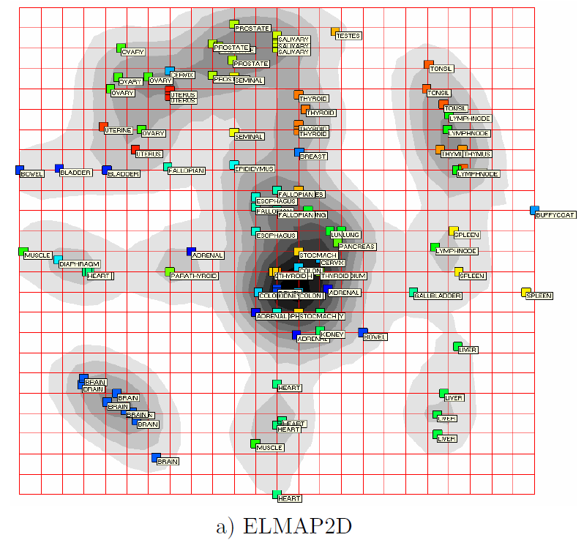
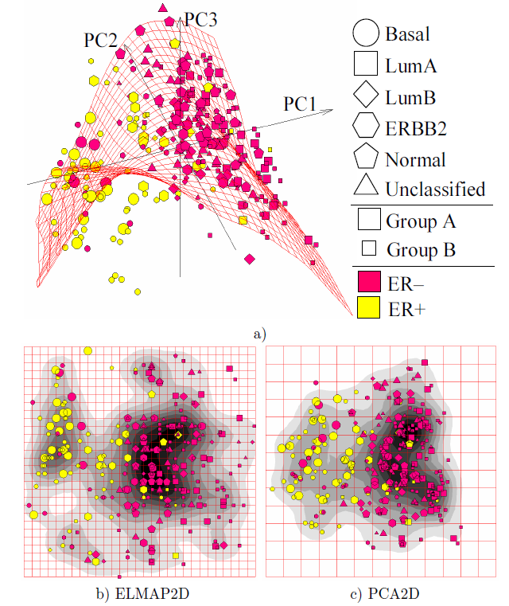
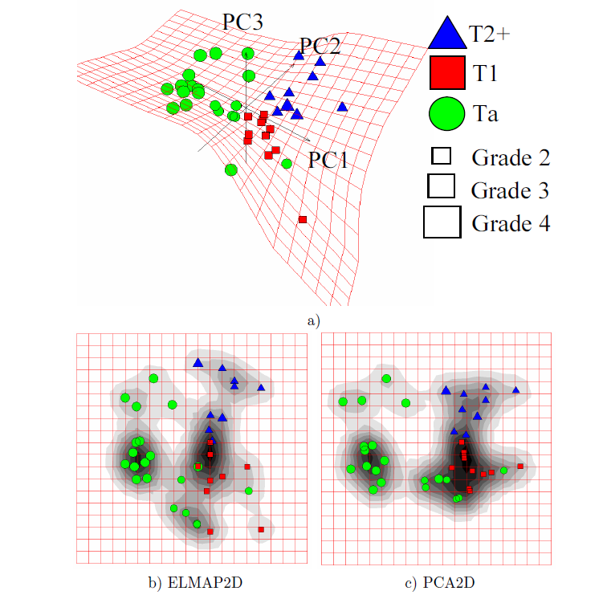
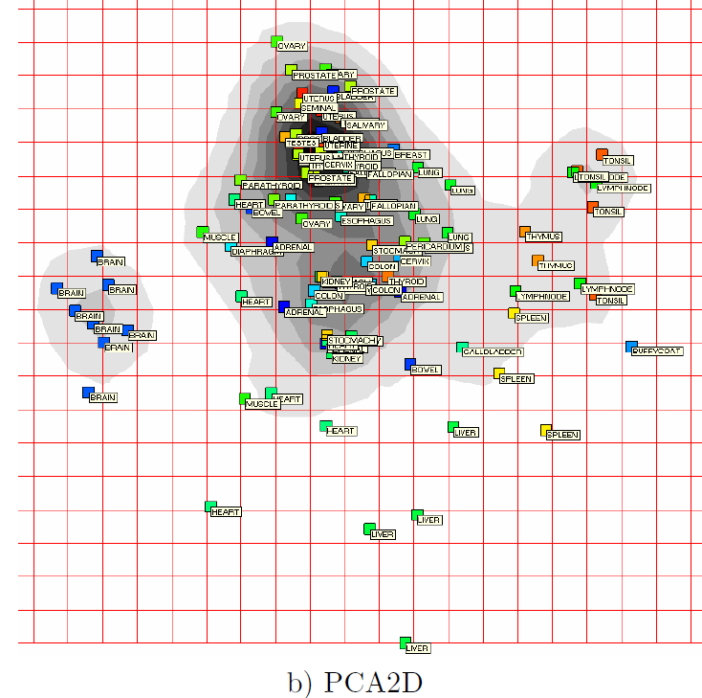
Are 2D non-linear projections better than 2D linear projections?
Bladder cancer
Dyrskjot et al., 2003
Breast cancer
Wang et al., 2005
Human tissues, Shyamsundar et al., 2005

Slide 18
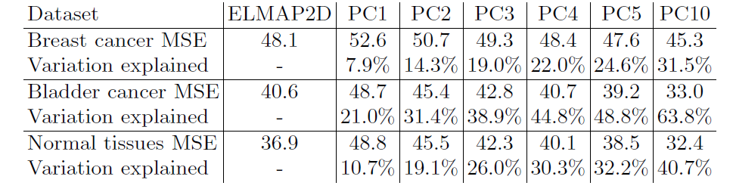
Yes: better approximation, smaller MSE (as expected)
(Gorban & Zinovyev, LNCSE, 2007)‏

Slide 19
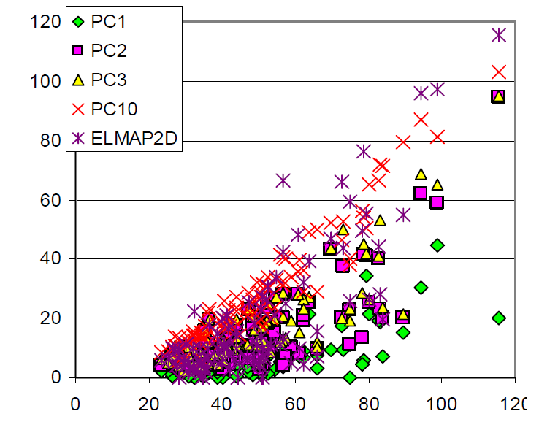
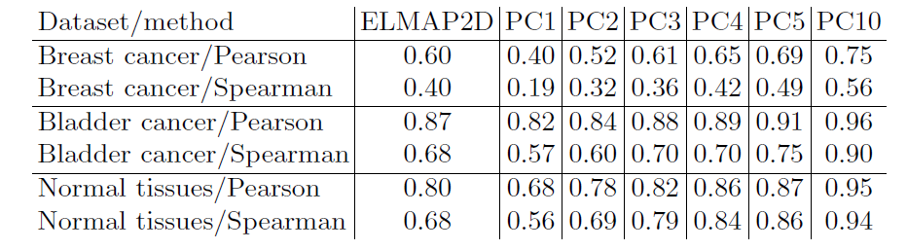
Yes: better representation of large distances
(already less trivial)
Sheppad’s plot
R^{N}
K points,
K(K-1)/2 pairwise
distances.
Natural PCA:
Select K most
representative
pairwise distances
Distance after projection
Initial distance
Quality of distance mapping (QDM) is a correlation coefficient between the pair-wise distances before and after projection onto the manifold:
(Gorban & Zinovyev, IJNS, 2010)‏

Slide 20
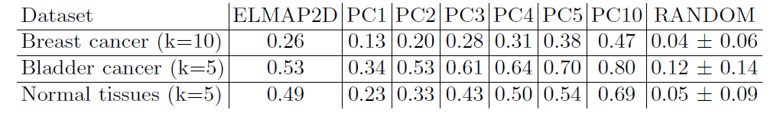
Yes: better point entourage preservation
(not necessarily expected)
R^{N}
R^{M<<N}
(Gorban & Zinovyev, IJNS, 2010)‏

Slide 21

Quality of point neighborhood preservation(QNP).
For every data point I we calculate the size of the intersection of the set of k neighbours calculated for embedding in the multi-dimensional space S(i; k) and in the low-dimensional space Ṥ(i; k).

Slide 22
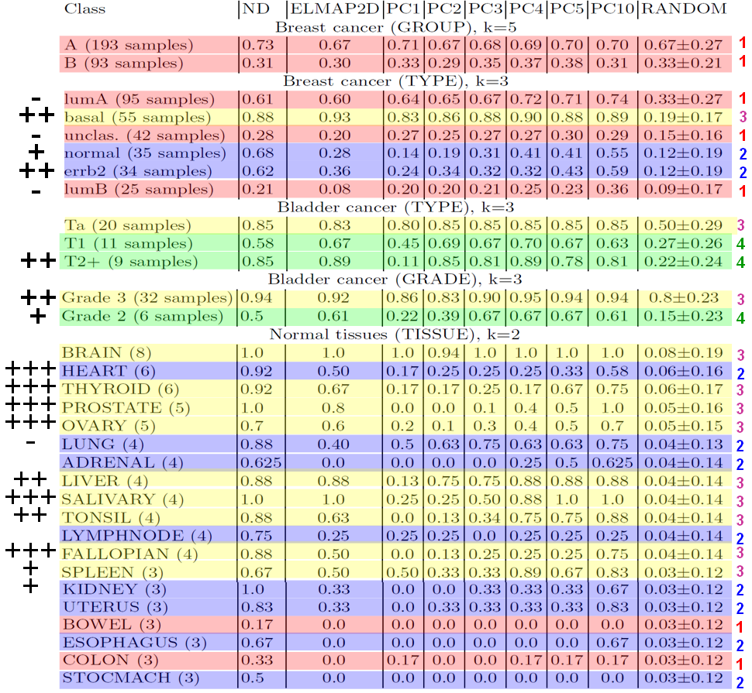
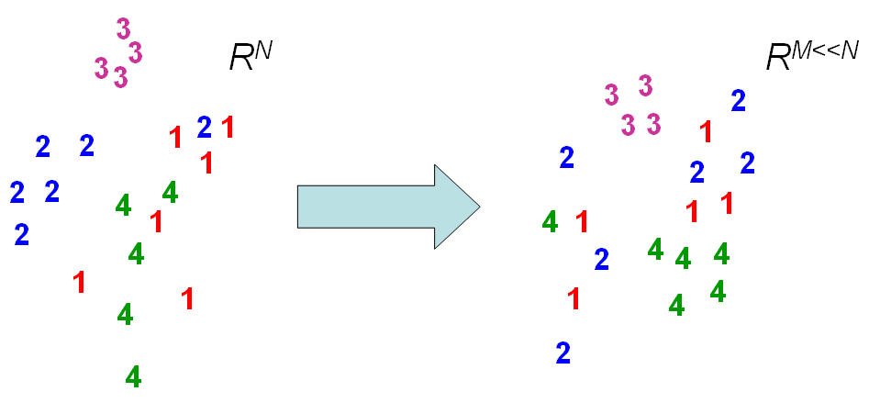
Yes: better class compactness
(not a trivial property)
“-” – non-linear is worse
“+” – non-linear is better
“++”, “+++” – non-linear is MUCH better
(Gorban & Zinovyev, IJNS, 2010)‏

Slide 23
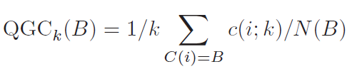
Quality of group compactness (QGC)
We assume that there is a label C(i) associated with every point i. N(B) is the number of points having the label B. For each label B, we calculate the average number of points with the same label in the k-neighborhood of the points before and after projection. Let us define c(i; k) as the number of points in the k-neighbourhood of the point i having the label C(i). For a label B,

Slide 24
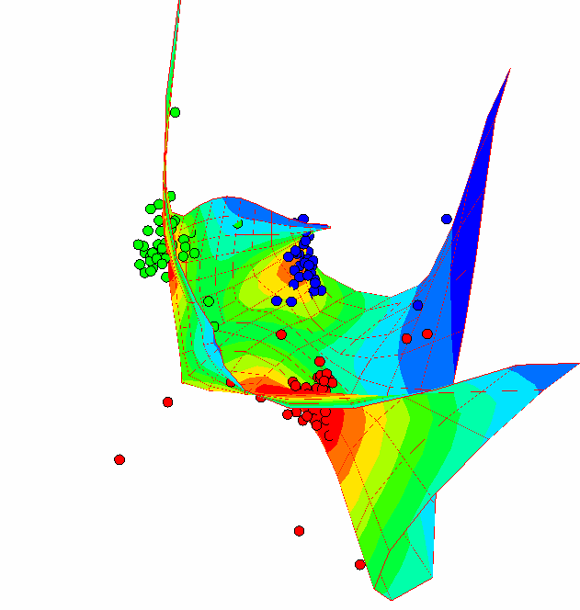
Principal graphs?
R^{N}
2-Star
3-Star
φ(V)
R^{N}
?

Slide 25
Generalization: what is principal graph?
Ideal object: pluriharmonic graph embedment
negative (repulsing) spring
Elastic k-star (k edges, k+1 nodes).
The branching energy is
S0
Ideal position of S0
(mean point of the star’s leaves)
2-stars (ribs)
Primitive elastic graph: all non-terminal nodes with k edges are elastic k-stars.
The graph energy is
3-stars
Pluriharmonic graph embedments generalize
straight line, rectangular grid (with proper choice of k-stars), etc.

Slide 26
Pluriharmonic map
Suppose that for each k ≥ 2, a family S_{k} of k-stars in G has been selected. Then we define an elastic graph as a graph with selected families of k‑stars S_{k} and for which for all E^{(i)} ∈ E and the corresponding elasticity moduli λ_{i} > 0 and μ_{kj} > 0 are defined.
Definition. A map φ:V→ R^{m} defined on vertices of G is pluriharmonic iff for any k-star with the central vertex and the neighbouring vertices, i = 1...k, the equality holds:

Slide 27
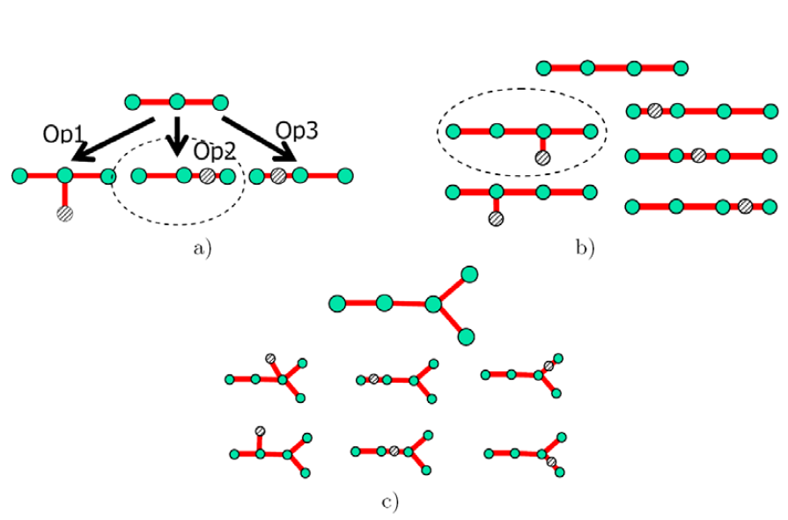
Graph grammars the simplest one: add a node, bisect an edge
Two operations:
Operation 1) Add a node to a star
Operation 2) Bisect an edge

Slide 28

Principal harmonic dendrites (trees) approximating complex data structures
Branching PCA
Non-linear PCA
Linear PCA

Slide 29
Three types of complexity
The principal graphs can be called data approximators of controllable complexity. By complexity of the principal objects we mean the following three notions:
Geometric complexity: how far a principal object deviates from its ideal configuration; for the elastic principal graphs we explicitly measure deviation from the ‘ideal’ pluriharmonic graph by the elastic energy U_{φ}(G) (3) (this complexity may be considered as a measure of non-linearity);
Structural complexity : it is some non-decreasing function of the number of vertices, edges and k-stars of different orders SC(G)=SC(|V|,|E|,|S₂|,…,|S_{m}|); this function penalises for number of structural elements;
Construction complexity is defined with respect to a graph grammar as a number of applications of elementary transformations necessary to construct given G from the simplest graph (one vertex, zero edges).

Slide 30



HC vs Principal Trees
“Genealogy tree”
“Metro map”
PCA, HC ordering

Slide 31



Geometrization of the text:
From DNA text to the space of frequency dictionaries
Fragmentation of the DNA text

Slide 32




Visualization of 7-cluster genome sequence structure
Algorithm iterations 3D PCA plot Metro map
Here clusters
overlapping on 3D PCA
plot are in fact well-separated
and the principal tree reveals this
fact

Slide 33


Hierarchical clustering vs principal trees, or
Genealogy tree vs Metro map
(Gorban, Sumner & Zinovyev, LNCSE, 2007)‏
Genealogy tree
Microarray data from
Shyamsundar et al. Genome Biology, 2005
Gene expression in 103 normal human tissue
samples
10383-dimensional space, many missing values
Similar tissues are closely clustered
The tree allows to estimate ‘distance’
between human tissues
Metro map

Slide 34



Software https://github.com/lamhda
http://bioinfo-out.curie.fr/projects/elmap/
http://bioinfo-out.curie.fr/projects/vidaexpert
http://bioinfo-out.curie.fr/projects/vimida

Slide 35
Conclusion
Method of elastic maps: Efficient method and interactive software for constructing low-dimensional non-linear principal manifolds;
Principal manifold as a screen for visualizing multidimensional data and functions with their uncertainties;
Non-linear data visualization displays are systematically better than linear ones (four quality criteria: MSE, Distance mapping,
Point entourage, Class compactness);

Slide 36
Pluriharmonic graphs (with quadratic energy functionals for deviation from the ideal form) provide us with a rich set of approximants;
Topological grammars and E/M algorithms form an effective technology for datasets approximation;
Metro maps provide us with a nice robust visualisation tool;
It works.

Slide 37

Динамическое фенотипирование как революция в классификации патологических состояний
Прецизионная медицина – пациент как уникальная экосистема
Заболевание как клиническая траектория (текущее состояние и все состояния в прошлом) в пространстве большой размерности
Пример – детальная клиническая база всех жителей Дании (7 млн. жителей)
Jensen et al, 2014,
Nature Comm

Slide 38

Омики всех отдельных клеток
(Single Cell Omics)
Cостояние организма как совокупности молекулярных состояний всех его клеток (одноклеточный подход), размерность ~10¹⁴ клеток × ~10⁴ генов = ~10¹⁸ (сегодня мы работаем с ~10⁸)
Пример – проект LifeTime, >50 исследовательских центров в Европе

Slide 39
Динамическое фенотипирование методом главных графов
Проблема – диахронные данные дорогие и редкие, синхронные данные не имеют метки времени
Решение – модель данных как
«букета расходящихся
клинических траекторий»
Апробация на базе данных осложнений инфаркта миокарда, собранной в Красноярском Государственном Медицинском Университете (С.Головенкин, 1998-2020)

Slide 40


Динамические фенотипы инфаркта миокарда
И диабета

Slide 41

Динамические фенотипы инфаркта миокарда
И диабета

Slide 42


Одноклеточные траектории

Slide 43
A. N. Gorban, A. Y. Zinovyev, Principal Graphs and Manifolds. In: Handbook of Research on Machine Learning, IGI Global, 2009. 28-59.
E-print: http://arxiv.org/abs/0809.0490
A. N. Gorban, A. Zinovyev, Principal manifolds and graphs in practice: from molecular biology to dynamical systems,
International Journal of Neural Systems, Vol. 20, No. 3 (2010) 219-232, E-print: http://arxiv.org/abs/1001.1122
H Chen, L Albergante, JY Hsu, CA Lareau, GL Bosco, J Guan, S Zhou, AN Gorban, DE Bauer, MJ Aryee, DM Langenau, A Zinovyev, JD Buenrostro, G-C Yuan, L Pinello, Single-cell trajectories reconstruction, exploration and mapping of omics data with STREAM. Nature communications. 2019 Apr 23;10(1):1903. https://doi.org/10.1038/s41467-019-09670-4

Slide 44
Albergante, L.; Mirkes, E.; Bac, J.; Chen, H.; Martin, A.; Faure, L.; Barillot, E.; Pinello, L.; Gorban, A.; Zinovyev, A. Robust and Scalable Learning of Complex Intrinsic Dataset Geometry via ElPiGraph. Entropy 2020, 22, 296. https://doi.org/10.3390/e22030296
More: just go to arXiv and look for gorban

Slide 45

Change of era
From Einstein’s “flight from miracle.”
«… The development of this world of thought is in a certain sense a continuous flight from “miracle”.»
To struggle with complexity
"I think the next century will be the century of complexity."
Stephen Hawking

Slide 46
Two main approaches in our struggle with complexity
A “minimal” space with this interesting content
Model reduction
Self-simplification in large dim
A large space
with something interesting inside
In high dimensionality many different things become similar, if we choose the proper point of view

Slide 47

Measure concentration effects
For large n
The Maxwell distribution
S^{n-1}
B^{n}
=
S^{n}
=
S^{n}
Projection
Maxwell
Gibbs
Milman
Talgrand
Gromov
………..
Gaussian
Density of shadow
Self-simplification in large dim

Slide 48
A 3D representation of an 8D hypercube
The body has the same radial distribution and the same number of vertices as the hypercube.
A very small fraction of the mass lies near a vertex.
Also, most of the interior is void.
(Illustration by Hamprecht & Agrell, 2002)
Self-simplification in large dim

Slide 49


Strange properties of high dimensional sets
Observable diameter of the sphere S^{n}, n = 3, 10, 100, 2500.
Illustrations by V. Pestov, 2005
Distribution of distances for pairs of points in the unit hypercube I^{n}, n = 3, 10, 100, 1000. (For random samples of 10,000 pairs.).

Slide 50
Three provinces of the Complexity Land
Wild complexity ???
Self-simplification
(Stat. Phys. …)
Reducible models
(Princ. Comp. …)

