Slide 1
Задачи проекта в области технологии МО и ИИ
А.Н. Горбань

Slide 2
Будет создано новое семейство методов, обеспечивающих быструю неитеративную коррекцию ошибок ИИ. Они создадут основу для сертифицированной робастности систем ИИ к возмущениям данных и модели. Результатом будут «сертификаты» робастности в виде вероятностей ошибок.
Будут проанализированы новые типы скрытых атак на ИИ, меняющих структуру модели незаметным для тестирования образом. Будет установлены условия существования распределенных скрытых атак, при которых возмущение распространяется на несколько узлов, но его влияние на отдельные узлы незначительно. Будет выработана процедура «сертификата безопасности» ИИ.
Будут получены новые и практичные оценки обобщающей способности корректоров. Это ответит на фундаментальный вопрос: почему модели ИИ с большой экспрессивностью обобщают? Полученные границы, наряду с оценками вероятности однократного обучения, дадут «сертификаты обучение» или «сертификаты адаптации».
Будут созданы методы выработки явного знания из неявных навыков систем МО и ИИ, основаные на двух взаимодействующих процессах: (а) упрощение структуры систем в ходе обучения и (б) передача навыков между системами в сообществах таких систем. Это позволит создавать сообщества систем МО и ИИ с возможностью логической интерпретации коллективных решений.

Slide 3
A problem about the problem
Gartner Hype Cycle: we are here
What problems will push us down the hill?

Slide 4
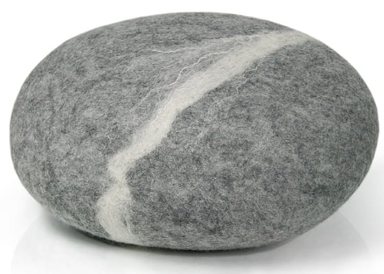
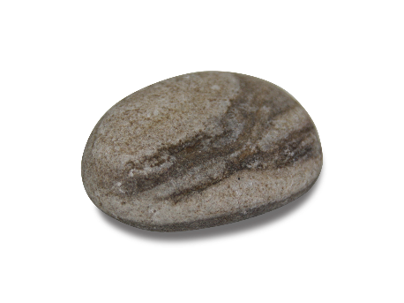
Two pebbles in a shoe
A mountain of success of Neural AI inspired us!
However, two pebbles in our shoes can slow down this fantastically successful movement:
AI makes unexpected mistakes, and will make them in the future;
Decisions of Neural AI are not transparent and, therefore, cannot be explained logically.

Slide 5


Slide 6
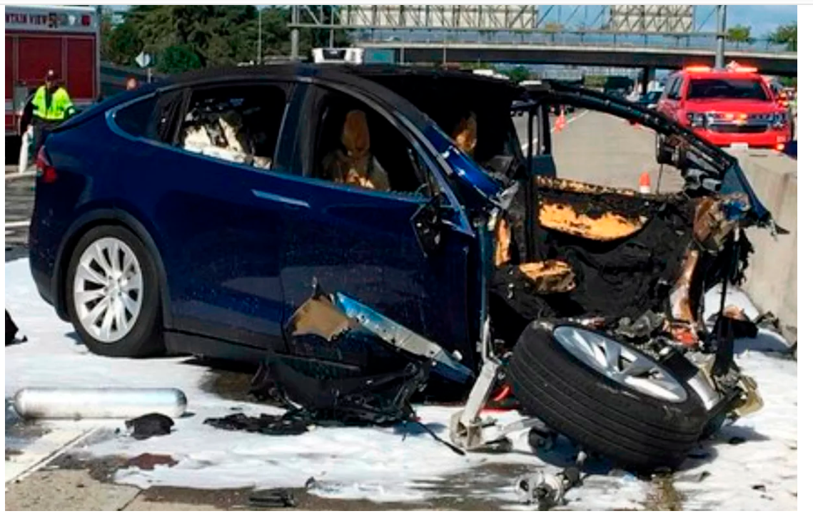

A Tesla electric car crashed into a highway barrier in Mountain View, California,
on March 23, 2018. Investigators confirmed that Autopilot was partially to blame.

Slide 7
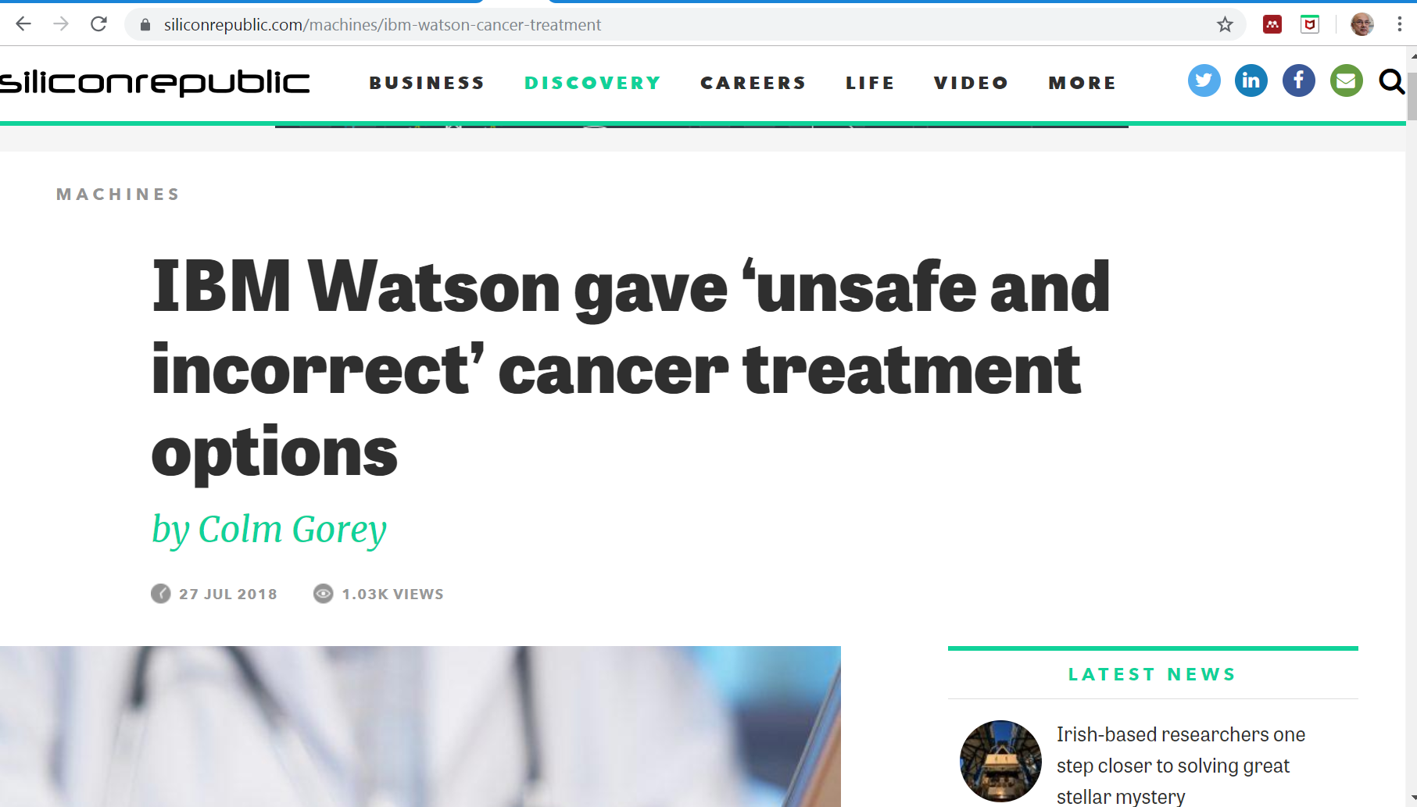

Slide 8
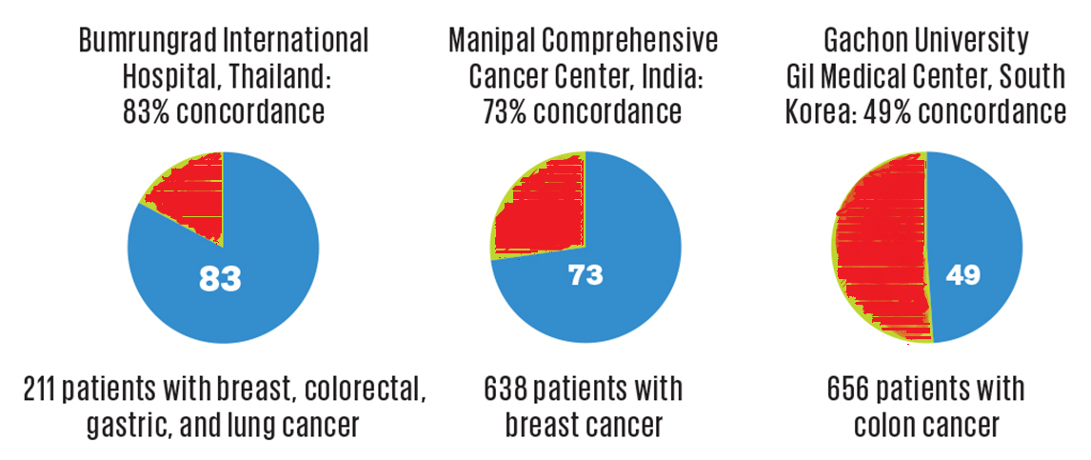
A 2016 audit by the University of Texas found that
the cancer centre spent $62 million on the project before canceling it.

Slide 9
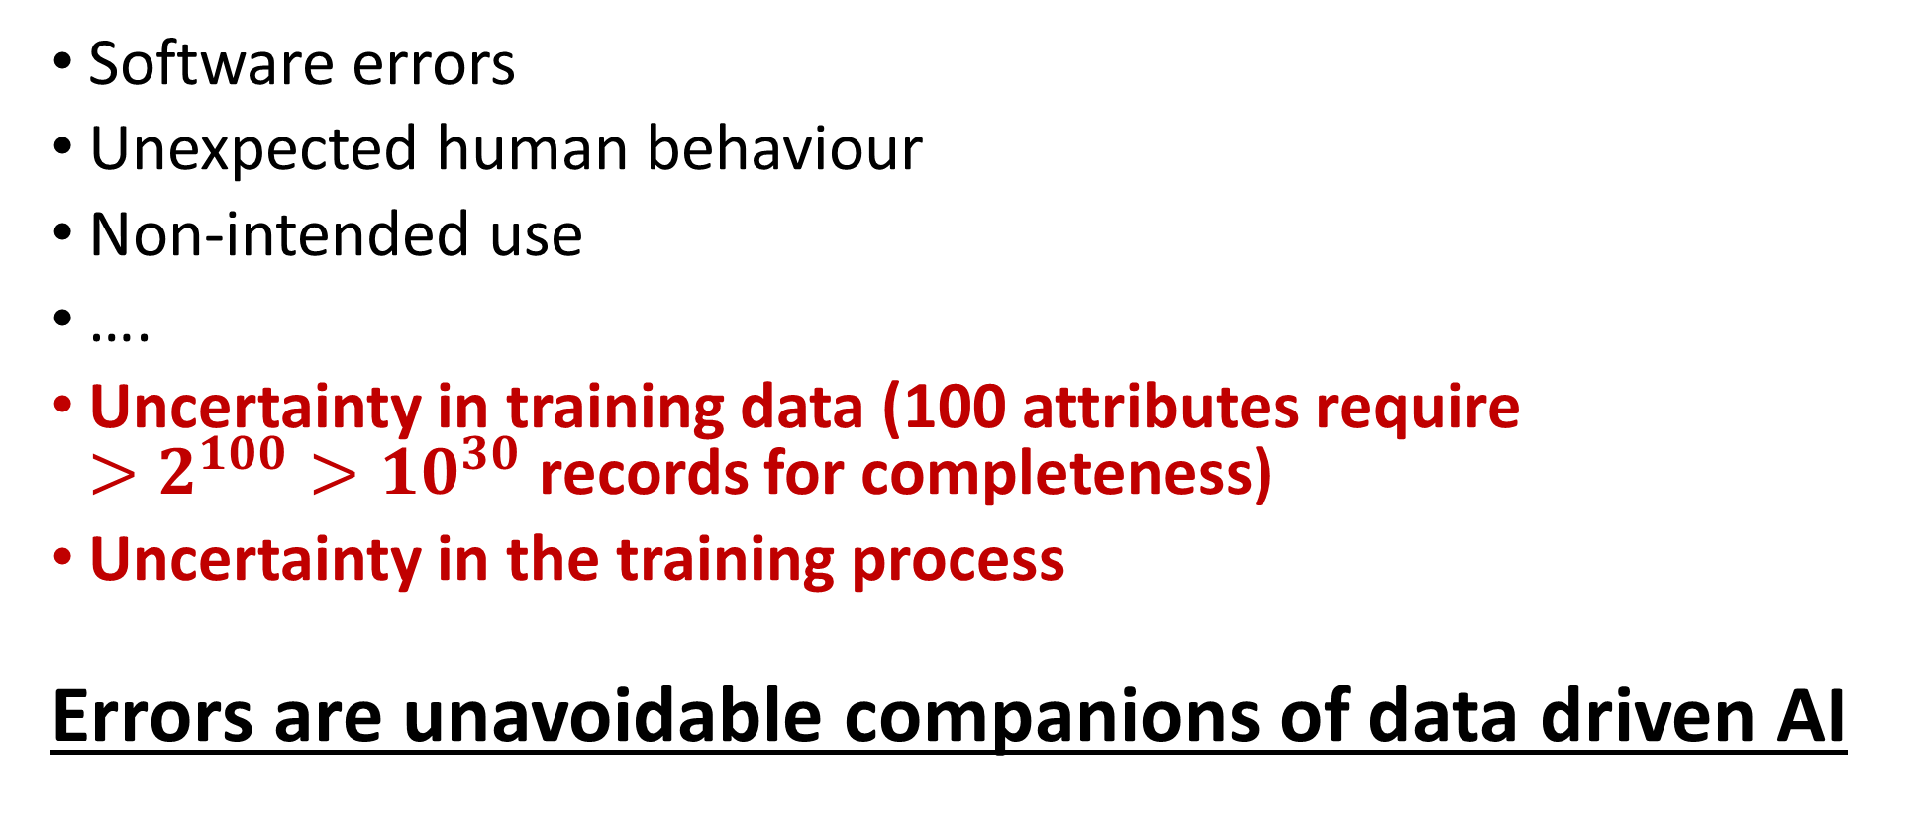
Fundamental origins of AI errors
Software errors
Unexpected human behaviour
Non-intended use
….
Uncertainty in training data (100 attributes require
$>2^{100}>{10}^{30}$ records for completeness)
Uncertainty in the training process
Errors are unavoidable companions of data driven AI

Slide 10
Message 1
The main AI 2020 problem:
Errors of AI and their processing
Errors are unavoidable companions of data driven AI

Slide 11

High-dimensional post-classical world
D. Donoho, from Stanford University webpage
The number of attributes p >> The number of examples N
This post-classical world is different from the ‘classical world’.
The classical methodology was developed for the ‘classical world’ based on the assumption of p < N, and N → ∞.
These results all fail if p > N.
The p > N case is not anomalous; it is the generic case.
Donoho, D.L. High-Dimensional Data Analysis: The Curses and Blessings of Dimensionality.
Invited Lecture at Mathematical Challenges of the 21st Century, AMS.

Slide 12
High-dimensional post-classical world
Comment 1
All the geometric blessing and curse of dimensionality effects
appear already when
p>>log N,
That is, the “post-classical world” effects begin long before p > N.
The non-classical world is around!
AN Gorban, VA Makarov, IY Tyukin, High-Dimensional Brain in a High-Dimensional World: Blessing of Dimensionality
Entropy 22 (1), 82, https://doi.org/10.3390/e22010082

Slide 13
High-dimensional post-classical world
Comment 2
The number of attributes differs significantly from the dimensionality of data.
The definition of the “post-classical world” should be modified to
Dim(DataSet)>>N,
or, according to Comment 1,
Dim(DataSet)>>log N.
About different definitions of data dimensionality related to blessing of dimensionality:
Bac, J., Zinovyev, A. (2020). Lizard brain: tackling locally low-dimensional yet globally complex organization
of multi-dimensional datasets. Frontiers in Neurorobotics, 13, 110. https://doi.org/10.3389/fnbot.2019.00110

Slide 14
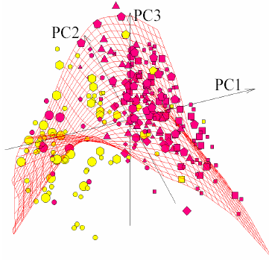
How to cope with the non-classical world?
Return to classics:
Reduce dimensionality
(PCA, ICA, Principal graphs and manifolds,
Autoencoders,… - methods of the previous
century with some modern improvements);
Data augmentation – smearing
data by random perturbations
(also well-known from 1990s).
Sometimes this works: A. Gorban, B. Kégl, D. Wunsch, A. Zinovyev (Eds.), Principal manifolds for data visualization and dimension reduction. Springer, (2008). Gorban, A. N., Zinovyev, A. Principal manifolds and graphs in practice: from molecular biology to dynamical systems. Int. J. Neural Syst., 20 (2010), 219-232.

Slide 15

How to cope with the non-classical world?
when return to classics is impossible?
An external device -
Corrector of AIs’
mistakes is needed
Technical requirements
Corrector should:
be simple;
not change the skills of the legacy system;
allow fast non-iterative learning;
allow correction of new mistakes without destroying previous corrections.
A.N. Gorban, I.Y. Tyukin, Blessing of dimensionality: mathematical foundations of the statistical physics of data. Philos. Trans. Royal Soc. A 376(2118), 20170237, 2018.

Slide 16
Corrector has to separate mistakes from correctly solved examples and correct them
Internal signals
Inputs
Outputs
Corrector is a binary classifier for error diagnosis equipped by the modified decision rule
for high risk situations.
Correction
Fisher’s linear discriminants separate errors from other examples surprisingly well in high dimensions.
Corrector
Gorban, A. N., Golubkov, A., Grechuk, B., Mirkes, E. M., Tyukin, I. Y. Correction of AI systems by linear discriminants: Probabilistic foundations. Information Sciences, 466 (2018), 303-322.

Slide 17
Fisher discriminants are explicit and non-iterative classifiers
(1) illustration
Let a data set Y be centralized (zero mean) and whitened (unit covariance matrix)
Definition. A point x is Fisher separable
from a finite set Y with a threshold α (0 ≤ α < 1) if
(x,y)≤α(x,x) (1)
for all y from Y.
Where (x,y) is the standard inner product.
L_{x}
x
•
y
c
y/α
•
•
•
Excluded volume
x does not belong to a ball
These simple discriminants effectively separate
mistakes from correctly solved examples in high dimensions.
Gorban, A. N., Burton, R., Romanenko, I., & Tyukin, I. Y. (2019). One-trial correction of legacy AI systems and stochastic separation theorems. Information Sciences, 484, 237-254.
17

Slide 18
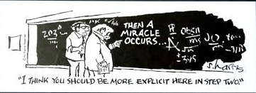
A miracle of stochastic separation
(an old joke about a new topic)
Gorban, A. N., Tyukin, I. Y. (2017). Stochastic separation theorems. Neural Networks, 94, 255-259.

Slide 19
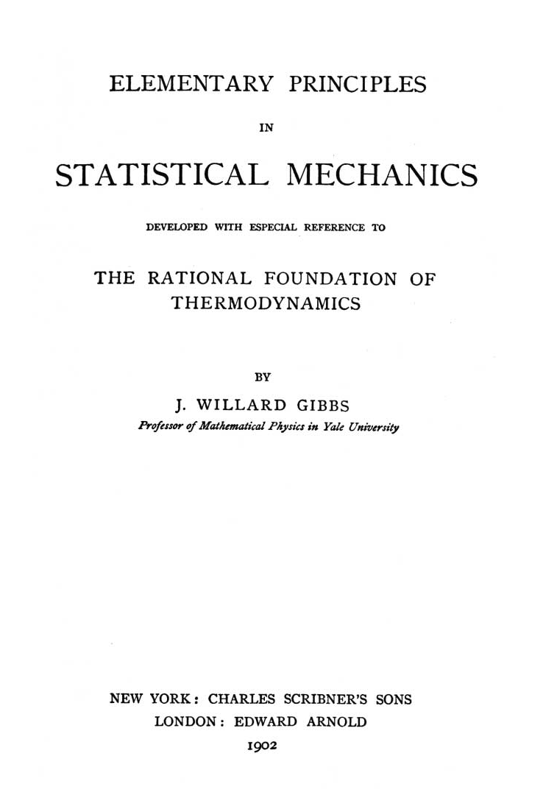
Blessing of dimensionality
The blessing of dimensionality is a manifestation of the concentration of measure.
All statistical physics is based on these phenomena.
Stochastic separation theorems represent a new class of them.
A.N. Gorban, I.Y. Tyukin, Blessing of dimensionality: mathematical foundations of the statistical physics of data. Philos. Trans. Royal Soc. A 376(2118), 20170237, 2018.
19

Slide 20
Plenty of generalizations for distributions
Arbitrary log-concave distributions
(logarithm of density is concave);
Convex combinations of a fixed number of log-concave distributions;
Product distributions with bounded support;
No i.i.d. assumptions.
Gorban, A. N., Golubkov, A., Grechuk, B., Mirkes, E. M., Tyukin, I. Y. Correction of AI systems by linear discriminants: Probabilistic foundations. Information Sciences, 466 (2018), 303-322.
Grechuk, B., Practical stochastic separation theorems for product distributions, 2019 International Joint Conference on Neural Networks (IJCNN), Budapest, Hungary, 2019, pp. 1-8.

Slide 21
Plenty of generalizations for distributions
Heuristic: The stochastic separation theorems hold if:
There are no heavy tails of the probability distribution;
The sets of small volume should not have large probability (what “small” and “large” mean is strictly defined for different contexts).
In these cases, Fisher discriminant is an effective tool for classification and AI correctors in high dimension

Slide 22
Plenty of generalizations for classifiers
Kernel classifiers
Tyukin, I. Y., Gorban, A. N., Grechuk, B., Green, S. (2019, July). Kernel Stochastic Separation Theorems and Separability Characterizations of Kernel Classifiers. In 2019 International Joint Conference on Neural Networks (IJCNN) (pp. 1-6). IEEE.

Slide 23
Plenty of generalizations for classifiers
Kernel classifiers;
Ensembles of correctors
(with clustering of errors);
A.N. Gorban, I.Y. Tyukin, Blessing of dimensionality: mathematical foundations of the statistical physics of data. Philos. Trans. Royal Soc. A 376(2118), 20170237, 2018.

Slide 24
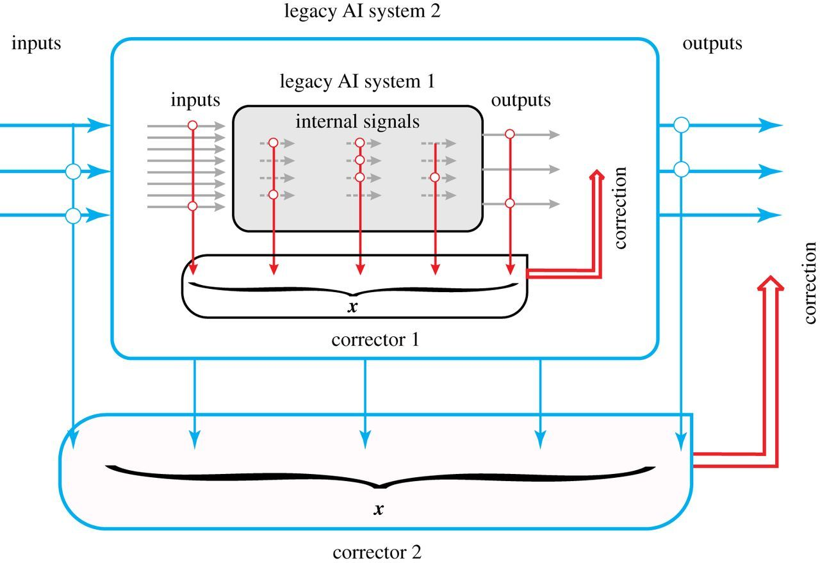
Plenty of generalizations for classifiers
Kernel classifiers;
Ensembles of correctors
(with clustering of errors);
Cascades of correctors.
A.N. Gorban, I.Y. Tyukin, Blessing of dimensionality: mathematical foundations of the statistical physics of data. Philos. Trans. Royal Soc. A 376(2118), 20170237, 2018.
24

Slide 25
Interiorisation of knowledge
Complex correctors can correct many errors.
But "technical debt" increases, and flexibility drops down.
The interiorisation of the collected knowledge is needed after all.
This is incorporation of knowledge into system’s inner structure.
Interiorisation can be organised as supervised learning that uses the system with correctors as the supervisor.
Sculley, D., Holt, G., Golovin, D.... & Dennison, D. (2015). Hidden technical debt in machine learning systems. In Advances in neural information processing systems (pp. 2503-2511).
Gorban, A. N., Grechuk, B., & Tyukin, I. Y. (2018). Augmented artificial intelligence: a conceptual framework. arXiv:1802.02172.

Slide 26
Message 2: Non-classical alternative
In the non-classical world we have a choice:
either return to classics,
or exploit the blessing of dimensionality
and create one-shot correctors of errors.

Slide 27


B. Program Scope – XAI Concept https://www.darpa.mil/program/explainable-artificial-intelligence
Today
Task
Why did you do that?
Why not something else?
When do you succeed?
When do you fail?
When can I trust you?
How do I correct an error?
Training Data
Machine Learning
Process
Learned
Function
Decision or
Recommendation
User
XAI
Task
Training Data
New Machine Learning
Process
Explainable Model
Explanation Interface
I understand why
I understand why not
I know when you succeed
I know when you fail
I know when to trust you
I know why you erred
User

Slide 28
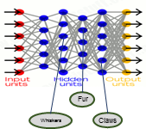
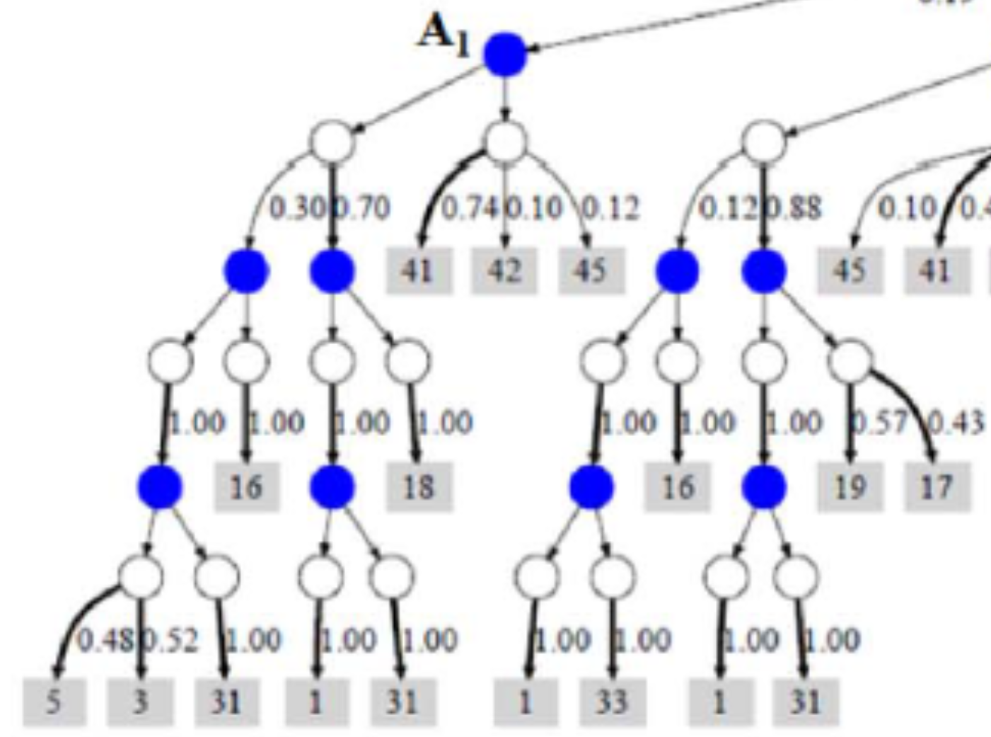
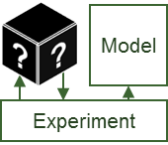
B.1 Explainable Models https://www.darpa.mil/program/explainable-artificial-intelligence
New
Approach
Learning Techniques (today)
Explainability
(notional)
Neural Nets
Create a suite of machine learning techniques that
produce more explainable models, while maintaining a high level of learning performance
Graphical
Models
Deep
Learning
Ensemble
Methods
Bayesian
Belief Nets
Prediction Accuracy
SRL
Random
Forests
AOGs
CRFs
HBNs
Statistical
Models
MLNs
Decision
Trees
Markov Models
SVMs
Explainability
Deep Explanation
Modified deep learning techniques to learn explainable features
Interpretable Models
Techniques to learn more structured, interpretable, causal models
Model Induction
Techniques to infer an explainable model from any model as a black box

Slide 29
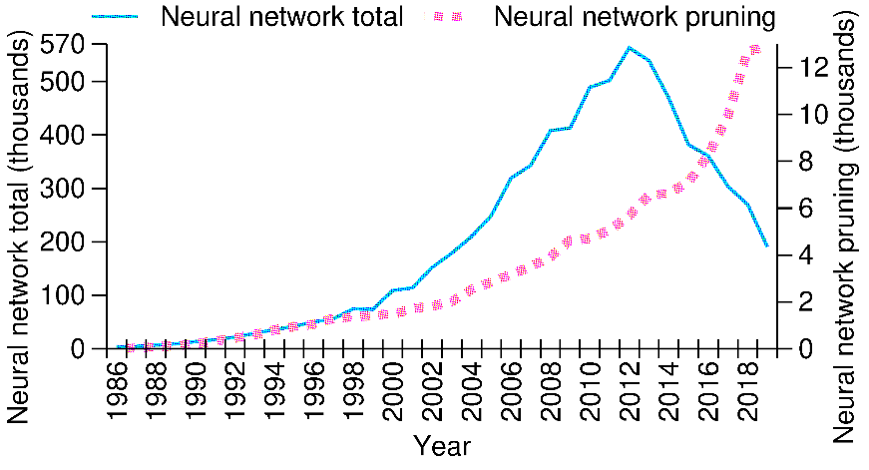
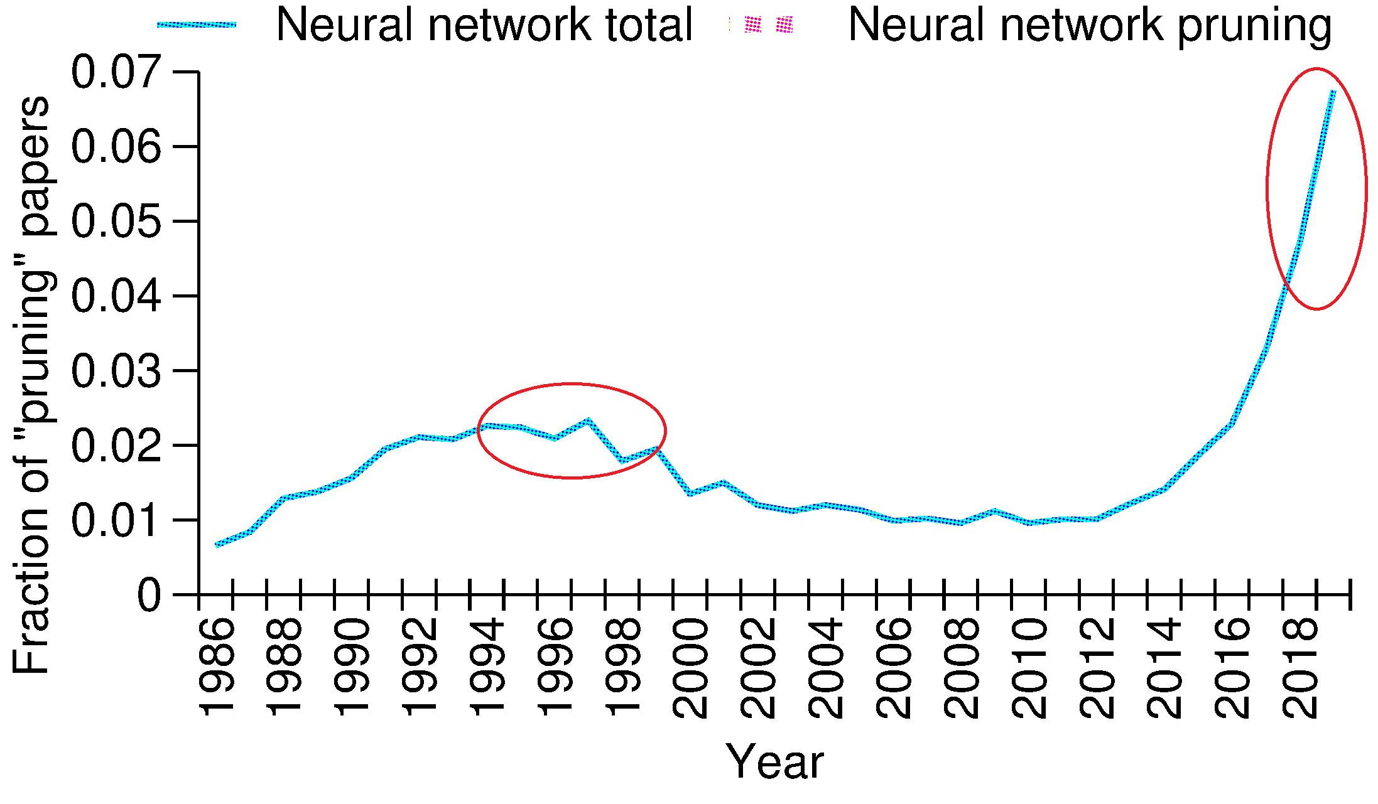
Neural network paper tendency
The first paper of NN pruning was written approximately at the time of NN development
The development of theory of NN (include deep learning) is mostly completed
New procedures of NN pruning appears each year

Slide 30
Problems for NN pruning
Feature selection: removal of neurons in the input layer. (Shallow NN)
Search of appropriate architecture to solve the problem and prevent overfitting. (Removing of neurons in Shallow NN and filters in CNN)
Reduction of precision of synaptic weights to provide cheap and fast implementation of trained NN.
Replacement of the activation function of neurons with a simple function.
Uniform network simplification for knowledge extraction. (Shallow NN)
Usage of truncated CNN as feature generator.

Slide 31
Sensitivity indicators
Zero order sensitivity indicators (remove and check).
First order sensitivity indicators (gradient based).
The backpropagation procedure provides the calculation of the derivative of loss function L for every element of the training set with respect to inputs of each neuron, outputs of each neuron and synaptic weights.
Average along the training trajectory – delete the less important elements – teach and test
Second order sensitivity indicators (Hessian matrix based – too expensive).

Slide 32
Message 3: Explainable models
Explainable models are expected to enable end users
to understand,
appropriately trust,
and effectively manage
the emerging generation of Artificial Intelligence (AI) systems.

Slide 33
Будет создано новое семейство методов, обеспечивающих быструю неитеративную коррекцию ошибок ИИ. Они создадут основу для сертифицированной робастности систем ИИ к возмущениям данных и модели. Результатом будут «сертификаты» робастности в виде вероятностей ошибок.
Будут проанализированы новые типы скрытых атак на ИИ, меняющих структуру модели незаметным для тестирования образом. Будет установлены условия существования распределенных скрытых атак, при которых возмущение распространяется на несколько узлов, но его влияние на отдельные узлы незначительно. Будет выработана процедура «сертификата безопасности» ИИ.
Будут получены новые и практичные оценки обобщающей способности корректоров. Это ответит на фундаментальный вопрос: почему модели ИИ с большой экспрессивностью обобщают? Полученные границы, наряду с оценками вероятности однократного обучения, дадут «сертификаты обучение» или «сертификаты адаптации».
Будут созданы методы выработки явного знания из неявных навыков систем МО и ИИ, основаные на двух взаимодействующих процессах: (а) упрощение структуры систем в ходе обучения и (б) передача навыков между системами в сообществах таких систем. Это позволит создавать сообщества систем МО и ИИ с возможностью логической интерпретации коллективных решений.

